Slide 1
Advanced database management systems

Slide 2
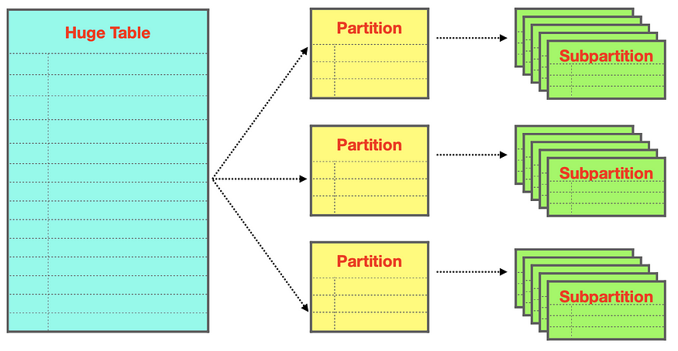
1. Distributed and ORDBMS Concepts (CO1)
Distributed Databases: These are databases where data is distributed across different locations (nodes). Partitions in distributed databases improve performance and scalability.

Slide 3
Hash Partitioning: Distribute rows based on a hash function.
Range Partitioning: Data is distributed by specifying a range of values.
List Partitioning: Data is partitioned based on a list of predefined values.

Slide 4
Hash Partitioning
In hash partitioning, rows are distributed across partitions based on the value of a hash function applied to a column. This ensures a uniform distribution of data.
CREATE TABLE Orders (
order_id INT,
customer_id INT,
order_date DATE,
total_amount DECIMAL(10, 2)
)
PARTITION BY HASH(customer_id) PARTITIONS 4;
he above query partitions the Orders table into 4 partitions based on a hash of the customer_id. This ensures that each partition holds a roughly equal number of rows.

Slide 5
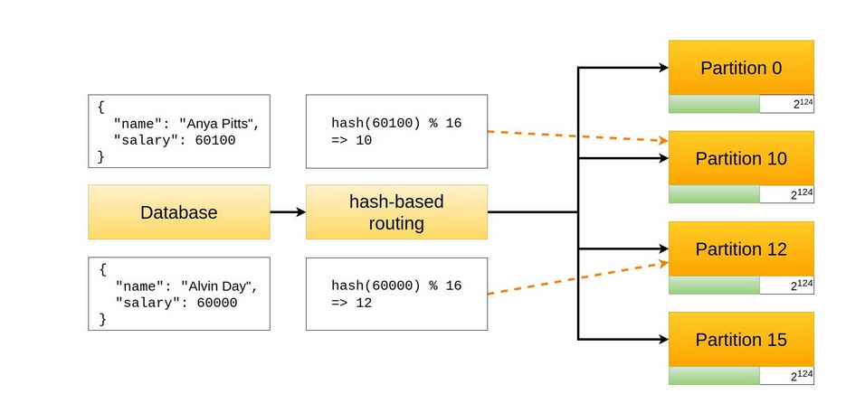
Hash Partitioning

Slide 6
Disadvantages of hash partition
Non-Sequential Data Retrieval: Since data is distributed randomly based on the hash function, retrieving sequential data (e.g., for date ranges) can be inefficient because it may span multiple partitions.
Load Balancing: If the hash function isn't well-chosen, partitions may end up unevenly loaded, leading to performance bottlenecks.
Hard to Predict: It is difficult to predict which partition will hold a particular piece of data without evaluating the hash function, making manual partition management tricky.

Slide 7
Range Partitioning
Range partitioning divides data based on specific ranges of a column's values. This is useful when your data naturally falls into continuous ranges.
CREATE TABLE Sales (
sale_id INT,
sale_date DATE,
amount DECIMAL(10, 2)
)
PARTITION BY RANGE(YEAR(sale_date)) (
PARTITION p0 VALUES LESS THAN (2010),
PARTITION p1 VALUES LESS THAN (2015),
PARTITION p2 VALUES LESS THAN (2020),
PARTITION p3 VALUES LESS THAN MAXVALUE
);
This query creates partitions of the Sales table, dividing sales records based on the year of sale_date. For example, data from 2010–2014 goes to p1, and so on.

Slide 8
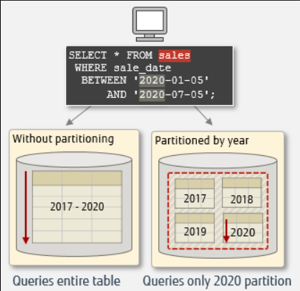
Range Partitioning

Slide 9
Range Partitioning
Skewed Data Distribution: If data isn't evenly distributed across the range, certain partitions may become overloaded while others remain underutilized (e.g., if most of the data falls in a small date range).
Complex Maintenance: Adding new ranges may require repartitioning the entire dataset, which can be complex and time-consuming.
Poor Scalability: As the data grows, maintaining an optimal range setup becomes more challenging, especially if the ranges need frequent adjustments.

Slide 10
List Partitioning
In list partitioning, rows are assigned to partitions based on a set of predefined values.
CREATE TABLE Employees (
emp_id INT,
emp_name VARCHAR(100),
department VARCHAR(50)
)
PARTITION BY LIST(department) (
PARTITION p_sales VALUES IN ('Sales'),
PARTITION p_hr VALUES IN ('HR'),
PARTITION p_finance VALUES IN ('Finance'),
PARTITION p_others VALUES IN ('Marketing', 'Support')
);
This query partitions the Employees table based on the department column. Employees in the 'Sales' department go into the p_sales partition, and so on.

Slide 11
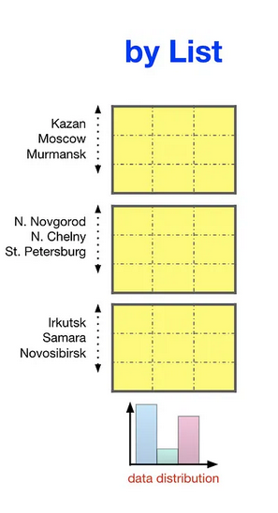
List Partitioning

Slide 12
List Partitioning
Manual Effort: Requires careful manual configuration to define the list of values, and adding new values may require schema changes.
Limited Use Cases: Best suited for categorical data with a finite set of known values. It doesn’t work well for data that doesn’t fit into predefined categories or when the number of distinct values increases over time.
Inefficient for Large Lists: If the list of values grows too large, it becomes cumbersome and less efficient to manage.

Slide 13
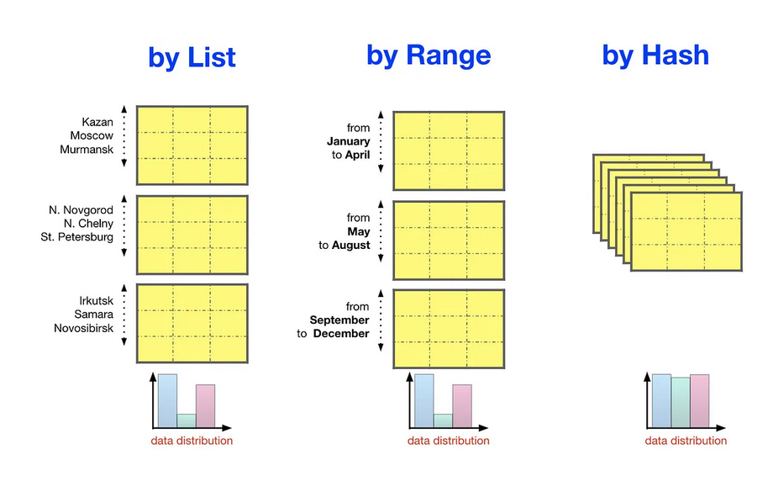
revise

Slide 14
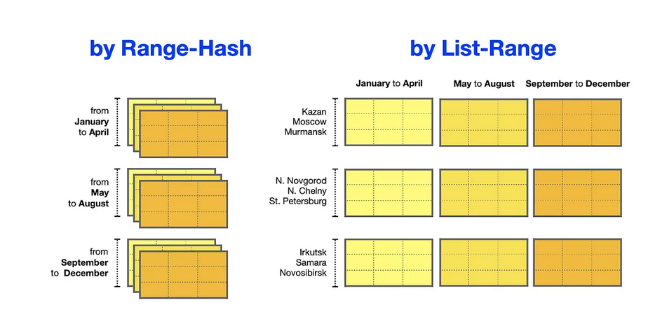
Hybrid partition

